Slide 1
Module 8:
Software Verification, Validation and Testing
Software Engineering
Faculty of Computing
Universiti Teknologi Malaysia

Slide 2
Recap on SDLC Phases & Artefacts
Domain Analysis
@ Business Process
Domain Model (Class Diagram)
1) Functional & Non-Functional Requirements
2) Use Case Diagram
Requirement
SRS
Analysis
1) Sequence Diagram
2) Activity Diagram
3) State Chart Diagram
Design
1) Class Diagram (refined)
2) Sequence Diagram (refined)
SDD
Implementation
1) Application Source Code
2) User Manual Documentation
Testing & Deployment
1) Test Cases
2) Prototype / Release / Versions
STD
Maintenance & Evolution
1) Change Request Form

Slide 3
Outline
Verification and Validation (V&V): Definition, goal, techniques and purposes
Inspection vs. testing: Complement to each other
Software testing:
  Definition, goal, techniques and purposes
  Stages: development, release, user/customer
  Process: test cases, test data, test results, test reports
  Focus in designing test cases to perform testing

Slide 4
Objectives
To discuss V&V differences and techniques
To describe different types of testing and its definition
To learn three strategies for generating system test cases

Slide 5
Verification vs. Validation
(Boehm, 1979)
Verification:
“Are we building the product right”
  The software should conform to its specification
Validation:
“Are we building the right product”
  The software should do what the user really requires

Slide 6
Verification vs. Validation
Verification | Validation
The verifying process includes checking documents, design, code, and program | It is a dynamic mechanism of testing and validating the actual product
It does not involve executing the code | It always involves executing the code
Verification uses methods like reviews, walkthroughs, inspections, prototyping etc. | It uses methods like Black Box Testing, White Box Testing, and non-functional testing, prototyping etc.
Whether the software conforms to specification is checked | It checks whether the software meets the requirements and expectations of a customer
Target is application and software architecture, specification, complete design, high level, and database design etc. | Target is an actual product
It comes before validation | It comes after verification

Slide 7
V&V Goal
V&V should establish confidence that the software is fit for purpose
This does NOT mean completely free of defects
It must be good enough for its intended use and the type of use will determine the degree of confidence that is needed

Slide 8
V&V: Degree-of-Confidence Category
Software function/purpose
  The level of confidence depends on how critical the software is to an organisation e.g. safety-critical system
User expectations
  Users may have low expectations of certain kinds of software (user previous experience, unreliable software especially newly installed software)
Marketing environment
  Getting a product to market early may be more important than finding defects in the program (competitive environment – release program first without fully tested to get the contract from customer)

Slide 9
Verification Technique: Software Inspection
The technique involves people examining the source representation with the aim of discovering anomalies (deviation from standard/expectation) and defects (errors)
It does not require execution of a system – static test, so it may be used before implementation
They may be applied to any representation of the system (e.g. requirements, design, test data)
It is an effective technique for discovering program errors

Slide 10
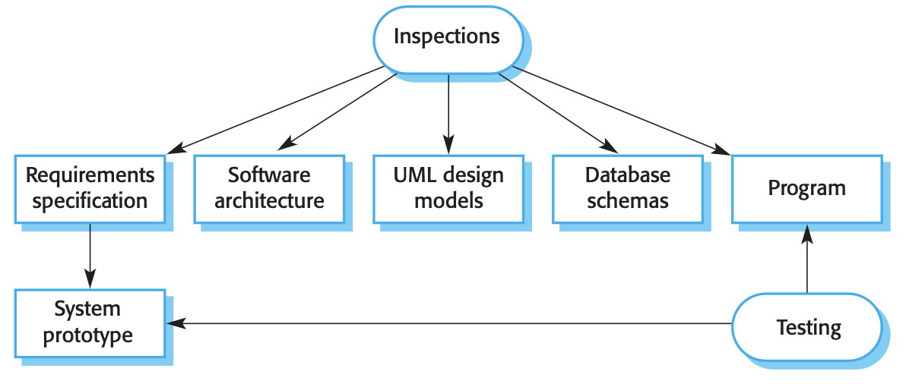
Software Inspection: Static Testing
Inspection (static)
Notes:
Requirements Verification: Verify that the documented requirements are clear, complete, and consistent. This involves reviewing the requirements specifications, identifying any ambiguities or contradictions, and ensuring that the requirements are feasible and traceable.
Design Verification: Verify that the software design correctly implements the specified requirements. This involves reviewing the design documents, checking for any design errors or omissions, and confirming that the design satisfies the functional and non-functional requirements.
Code Verification: Verify that the software code is implemented correctly according to the design and meets the specified requirements. This involves reviewing the code for syntax errors, logic flaws, and adherence to coding standards. Static code analysis tools can also be used for automated code verification.
Unit Testing Verification: Verify that the unit tests are designed and executed effectively to validate the behavior of individual software components. This involves reviewing the unit test cases, ensuring they cover different code paths and edge cases, and confirming that the unit tests provide adequate code coverage.
Integration Testing Verification: Verify that the integration tests are conducted to ensure the correct interaction and communication between different software components/modules. This involves reviewing the integration test plan, checking for test coverage of integration scenarios, and ensuring that the integration tests pass successfully.
System Testing Verification: Verify that the system tests are designed and executed to validate the behavior of the software as a whole. This involves reviewing the system test plan, checking for test coverage of end-to-end scenarios, and ensuring that the system tests cover the functional and non-functional requirements.
Regression Testing Verification: Verify that regression tests are conducted after modifications or updates to the software to ensure that existing functionality is not negatively affected. This involves reviewing the regression test suite, ensuring that it covers the impacted areas, and confirming that the tests are executed and passed successfully.
Documentation Verification: Verify that the documentation related to the software, such as user manuals or technical specifications, is accurate, up to date, and complete. This involves reviewing the documentation, checking for any discrepancies or missing information, and ensuring that it aligns with the software implementation.

Slide 11
Advantages of Inspections
During testing, errors can mask (hide) other errors. As inspection is a static process, it need not to be concerned with interactions between errors.
Incomplete versions of a system can be inspected without additional costs. Compared to dynamic testing, if a program is incomplete, need to develop specialized test that is connected in order to test the parts that are available.
Besides searching for program defects, an inspection can also consider broader quality attributes of a program, such as compliance with standards, portability and maintainability (inefficiencies, inappropriate algorithms, poor programming style which make a system to be difficult to maintain & update).

Slide 12
Validation Technique: Dynamic Testing
Validation involves evaluating the software system to ensure that it meets the intended requirements and satisfies the user's needs and expectations.
Validation requires the execution of the software in real or simulated environments to validate its functionality, usability, and performance.
This includes interacting with the software, providing inputs, and evaluating the outputs to confirm that they align with the expected results and meet the user's requirements.
Validation also includes assessing non-functional aspects such as scalability, security, and reliability to ensure that the software meets the desired performance and quality standards. Compliance with industry regulations and standards may also be evaluated during the validation process.

Slide 13
Testing (Dynamic)
Testing (dynamic)
Notes:
Requirements Validation: Ensure that the requirements documented for the software accurately reflect the needs and expectations of the stakeholders. This involves reviewing the requirements specifications, identifying any inconsistencies or ambiguities, and confirming that the requirements are feasible and aligned with the project goals.
Design Validation: Verify that the software design meets the specified requirements and is capable of providing the desired functionality. This involves reviewing the design documents, checking for any design flaws, assessing whether the design is modular and maintainable, and validating that the design aligns with industry best practices and architectural principles.
Test Data Validation: Validate the test data used during the software testing process. This includes reviewing the test data sets, ensuring that they cover all relevant scenarios, and verifying that the test data adequately represents the expected usage patterns and input variations.
Functional Validation: Validate that the software functions as intended and meets the specified functional requirements. This involves reviewing the software code, examining the software behavior through simulations or prototypes, and confirming that the software performs the expected operations accurately and reliably.
Performance Validation: Validate that the software performs efficiently and effectively under expected load and stress conditions. This includes reviewing performance requirements, analyzing performance test results, and ensuring that the software meets the specified performance benchmarks.
User Acceptance Validation: Validate that the software meets the needs and expectations of the end-users or stakeholders. This involves involving end-users in the inspection process, gathering feedback, and conducting usability testing to ensure that the software is user-friendly, intuitive, and provides a satisfactory user experience.
Compliance Validation: Validate that the software complies with relevant industry standards, regulations, and legal requirements. This involves reviewing the software against applicable standards, performing compliance audits, and ensuring that the software meets all necessary regulatory criteria.

Slide 14
Inspections vs. Dynamic Testing?
Software inspection and review concerned with checking and analysis of the static system representation to discover problems (“static test”: no execution needed)
  May be supported by tool-based document and code analysis (“static analysis”)
Software testing concerned with exercising and
observing product behaviour (“dynamic test”: needs execution)
  The system is executed with test data and its operational behaviour is observed

Slide 15
Inspections vs. Dynamic Testing?
Inspections and dynamic testing are V&V verification techniques
Both should be used during the V&V process
Inspections can check conformance with a specification (system) but not conformance with the customer’s real requirements
Inspections cannot check non-functional characteristics such as performance, usability, etc.

Slide 16
Recap on Software (Dynamic) Testing
Software (dynamic) testing is concerned with exercising and observing product behaviour
Dynamic test: The system is executed with test data and its operational behaviour is observed
“Testing can only show the presence of errors, not their absence” (Dijkstra et al. 1972)

Slide 17
V&V Technique: Prototyping
“A software prototype is a partial implementation constructed primarily to enable customers, users, or developers to learn more about a problem or its solution.” [Davis, 1990]
“Prototyping is the process of building a working model of the system.” [Agresti,1986]
Prototyping can be used as a form of verification by verifying requirements, verifying design choices, validating functionality, and gathering user feedback. It allows stakeholders to visualize and interact with a working model of the software, enabling early identification of errors and issues before full-scale development.
While prototyping serves as a valuable verification technique, it should be supplemented with other verification activities, such as inspections, reviews, and testing, to ensure that the software meets the specified requirements and quality standards.

Slide 18
V&V Technique: Prototyping
Prototyping is used for validation in software development by providing stakeholders with a tangible representation of the software system. Through prototypes, requirements can be validated, design choices can be assessed, and user feedback can be gathered and incorporated.
Prototypes allow for testing and validation of the system's functionality, user experience, and alignment with user needs and expectations. By using prototyping for validation, software engineers can identify and address issues early in the development process, ensuring that the final product meets the desired objectives and delivers value to the end users.

Slide 19
V&V Technique: Model Analysis
Verification:
  Is the model well formed?
  Are the parts of the model consistent with one another?
Validation:
  Animation of the model on small examples
  Formal challenges: “if the model is correct, then the following property should hold...”
  ‘What if’questions:
    reasoning about the consequences of particular requirements
    reasoning about the effect of possible changes
    “will the system ever do the following...”

Slide 20
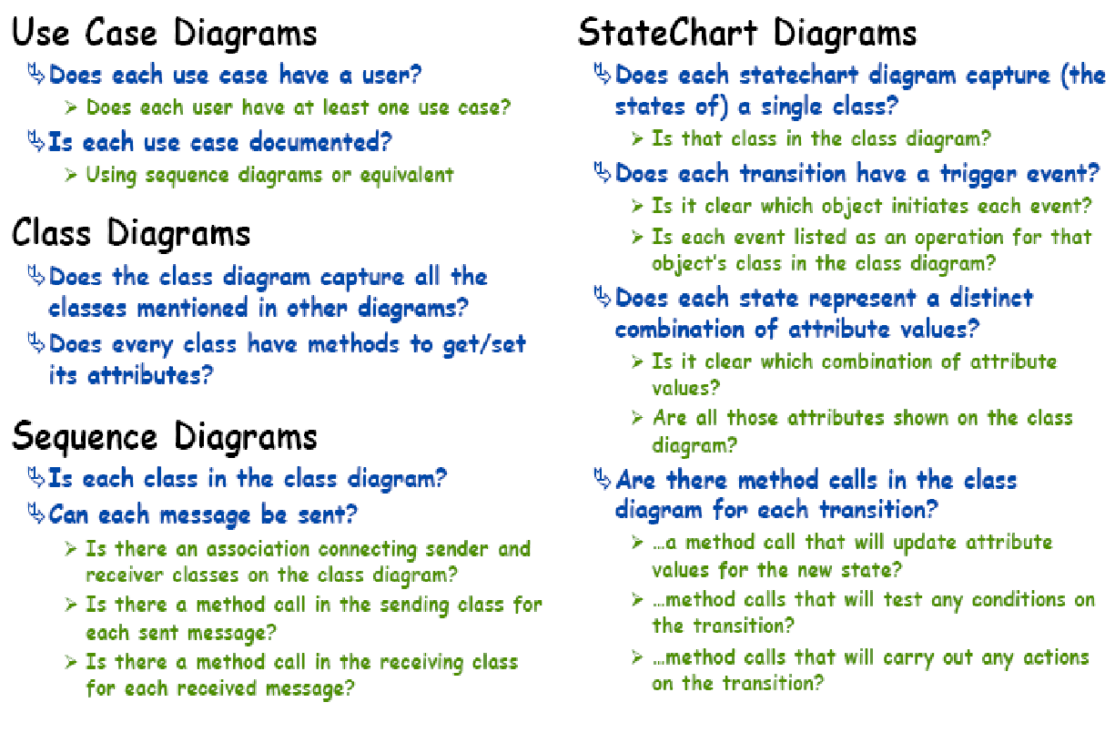
Verification Technique: Model Analysis
Example in Basic Cross-Check for UML Model

Slide 21
Stages of Testing
Commercial software requires 4 stages of testing:
Component test: Individual software components are tested during development to discover bugs and defects
Integration test: Testing is performed between integrated components during development
System test: Separate testing team tests a complete version of the system before it is released to users
Acceptance test: User/customers/authorised entity determine whether to accept the system through formal testing, which is conducted to check whether the system satisfies the acceptance criteria
Rex Black, Erik Van Veenendaal, Dorothy Graham (2012), Foundations of Software Testing - ISTQB® Certification, 3rd ed., Cengage Learning

Slide 22
Stages / Levels of Software Testing
1. Component
2. Integration
3. System
4. Acceptance
Object/Class
Interface
Top-down
Functional
a) Alpha
Parameter
Bottom-up
NF: Usability
b) Beta
Procedural
NF: Performance
c) UAT
Message Passing
NF: Stress

Slide 23
Stage 1: Component Test
Component or unit testing is the process of testing individual components in isolation. It is a defect testing process.
Components may be:
  Individual functions or methods within an object
  Object classes with several attributes and methods
  Composite components with defined interfaces used to access their functionality
Usually, it is the responsibility of the component developer (except sometimes for critical systems)
Tests are derived from the developer’s experience
Types of testing: (i) Object Class Testing (ii) Interface Testing

Slide 24
Component Test: Object Class Testing
Complete test coverage of a class involves:
  Testing all operations associated with an object
  Setting and interrogating all object attributes
  Exercising the object in all possible states

Slide 25
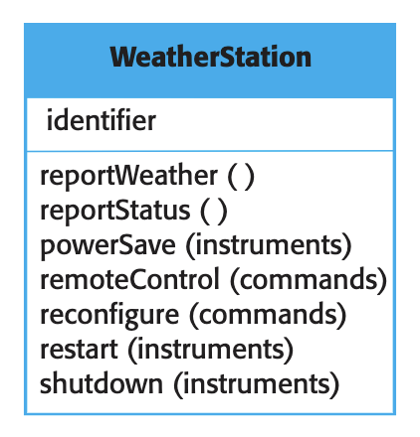
Object/Class Testing Example:
Weather Station Class
Need to define test cases for reportWeather, calibrate, test, startup and shutdown
Using a state model, identify sequences of state transitions to be tested and the event sequences to cause these transitions
Example:
Waiting 🡺 Calibrating 🡺 Testing 🡺
Transmitting 🡺 Waiting

Slide 26
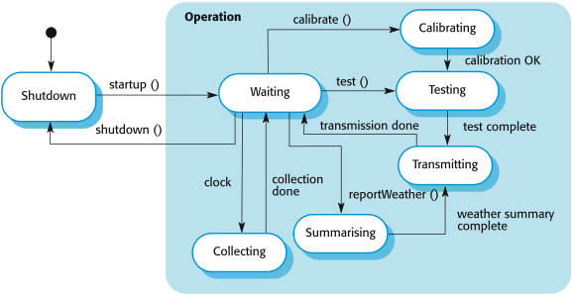
Object/Class Testing Example:
Weather Station Class (Cont.)
From weather class, create the related state diagram:
  Objects have state(s)
  One state transits from another state(s) that is triggered by an event that occurs, certain specific condition and action taken by the object

Slide 27
Component Test: Interface Testing
Objectives are to detect faults due to interface errors or invalid assumptions about interfaces
Particularly important for object-oriented development as objects are defined by their interfaces

Slide 28
Interface Testing Types
Parameter interface
  Data passed from one procedure to another
Procedural interface
  Sub-system encapsulates a set of procedures to be called by other sub-systems
Message passing interface
  Sub-systems request services from other sub-systems

Slide 29
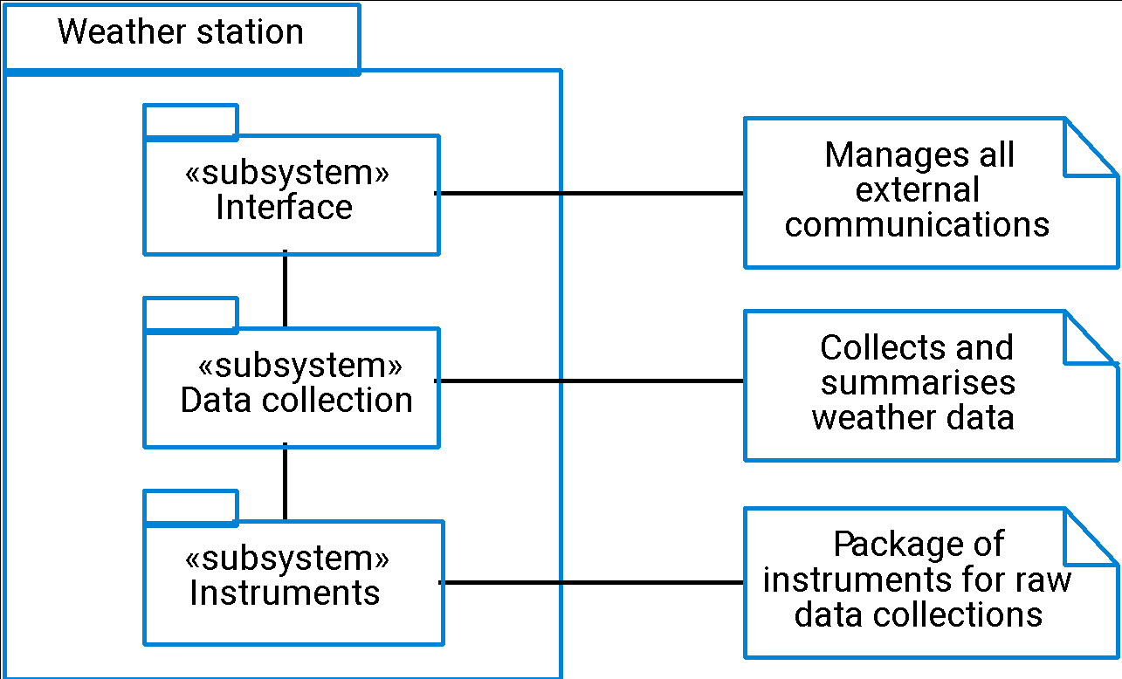
Layered Architecture - 3 Layers

Slide 30
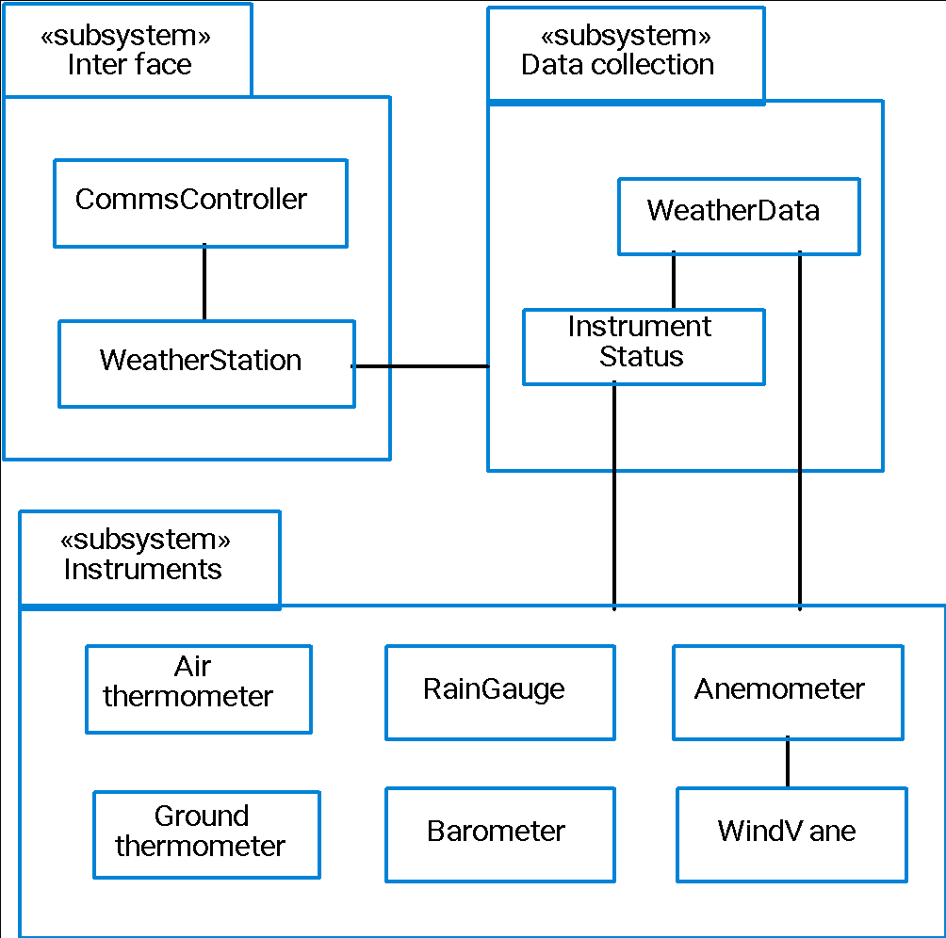
Weather Station Subsystems

Slide 31
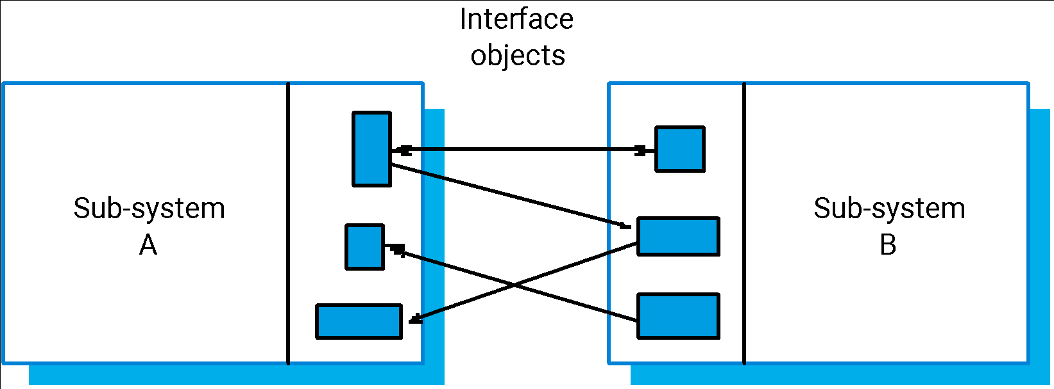
Sub-System Interfaces

Slide 32
Interface Errors
Interface misuse
  A calling component calls another component and makes an error in its use of its interface e.g. parameters in the wrong order
Interface misunderstanding
  A calling component embeds assumptions about the behaviour of the called component which are incorrect
Timing errors
  The called and the calling component operate at different speeds and out-of-date information is accessed

Slide 33
Stages / levels of Software Testing
1. Component
2. Integration
3. System
4. Acceptance
Object/Class
Interface
Top-down
Functional
a) Alpha
Parameter
Bottom-up
NF: Usability
b) Beta
Procedural
NF: Performance
c) UAT
Message Passing
NF: Stress

Slide 34
Stage 2: Integration Test
Testing during development involves integrating components to create a version of the system and then testing the integrated system
The test team has access to the system source code and the system is tested as integrated components
The focus in integration test is testing the interactions between components
Integration test checks that components are compatible, interact correctly and transfer the right data at the right time across their interfaces

Slide 35
Integration Test (cont.)
Involves building a system from its components and testing it for problems that arise from component interactions:
  Top-down integration:
    Develop the skeleton of the system and populate it with components
  Bottom-up integration:
    Integrate infrastructure components then add functional components
To simplify error localisation, systems should be incrementally integrated

Slide 36
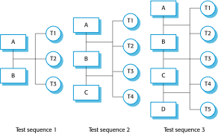
Incremental Integration Testing

Slide 37
Stages / levels of Software Testing
1. Component
2. Integration
3. System
4. Acceptance
Object/Class
Interface
Top-down
Functional
a) Alpha
Parameter
Bottom-up
NF: Usability
b) Beta
Procedural
NF: Performance
c) UAT
Message Passing
NF: Stress

Slide 38
Stage 3: System Test
Process of testing an integrated system to verify that it meets specified requirements
The test team (preferably independent testing team) test the complete system to be delivered as a black-box
Includes function test, function interaction (flow) and non-functional attributes
Three examples of system testing to test non-functional attributes:
  Stress testing
  Performance testing
  Usability testing

Slide 39
System Test (cont.)
The process of testing is a release of a system that will be distributed to customers
Primary goal is to increase suppliers’ confidence that the system meets its requirements
System test is usually black-box or functional testing:
  Based on the system specification only
  Testers do not have knowledge of the system implementation
  (see requirements test section later)

Slide 40
Stress Testing
The application is tested against heavy load e.g. complex numerical values, large number of inputs, large number of queries etc. which checks for the stress/load the applications can withstand
Example: Developing software to run cash registers
  Non-functional requirement:
    “The server can handle up to 30 cash registers looking up prices simultaneously.”
  Stress testing:
    Occur in a room of 30 actual cash registers running automated test transactions repeatedly for 12 hours

Slide 41
Performance Testing
Part of release testing may involve testing the emergent properties of a system e.g. performance and reliability
Example:
  Performance requirement:
    “The price lookup must complete in less than 1 second”
  Performance testing:
    Evaluates whether the system can look up prices in less than 1 second (even if there are 30 cash registers running simultaneously)

Slide 42
Usability Testing
Testing is conducted to evaluate the extent to which a user can learn to operate, prepare inputs for and interpret outputs of a system or component
Usually done by human-computer interaction specialist that observe humans interacting with the system

Slide 43
Stages / levels of Software Testing
1. Component
2. Integration
3. System
4. Acceptance
Object/Class
Interface
Top-down
Functional
a) Alpha
Parameter
Bottom-up
NF: Usability
b) Beta
Procedural
NF: Performance
c) UAT
Message Passing
NF: Stress

Slide 44
Stage 4: Acceptance Test
Formal testing with respect to user needs, requirements, and business processes conducted to determine whether or not a system satisfies the acceptance criteria and to enable the user, customers or other authorized entity to determine whether or not to accept the system
Customers test a system to decide whether or not it is ready to be accepted from the system developers and deployed in the customer environment, primarily for custom systems
Goal is to establish confidence in the system/part-system or specific non-functional characteristics (e.g. performance), usually for ensuring the system is ready for deployment into production

Slide 45
Acceptance Test (cont.)
Acceptance test is a stage in the testing process in which users or customers provide input and advice on system testing
Acceptance test is essential, even when comprehensive system testing have been carried out
The reason for this is that influences from users’ working environment have a major effect on the reliability, performance, usability and robustness of a system
These cannot be replicated in a testing environment

Slide 46
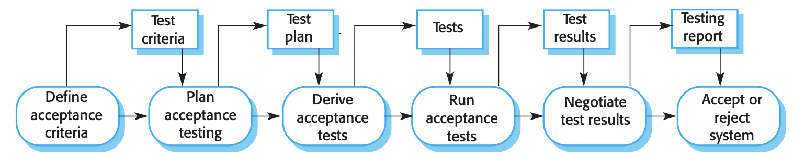
Acceptance Testing Process

Slide 47
Types of Acceptance Test
Alpha testing
  Users of the software work with the development team to test the software at the developer’s site
  In-house test
Beta testing
  Early testing of stable product by customers / users
  A release of the software is made available to users to allow them to experiment at their site and to raise problems that they discover with the system developers
  published reviews of beta release test results can make or break a product (e.g. PC games)
User Acceptance Testing (UAT)
  Conducted by or visible to the end user & customer at the final stage of validation
  Testing based on the defined user requirements which often uses the ‘thread testing’ approach – the same ones for functional system test

Slide 48
Test Case Design Technique (dynamic testing)
b) Black-box
Requirements based/ specification based testing is an example of black box testing
c) White-box
i) Equivalence Partitioning
ii) Boundary Value Analysis
i) Basis Path
ii) Control Structure
Step 1: draw Flow Graph
Step 2 : calculate Cyclomatic Complexity
Step 3: identify Independent Path
Step 4: Generate Test cases

Slide 49
Test-Case Design Technique:
Black-Box Testing
Also called functional testing and behavioral testing
Focuses on determining whether or not the program does what it is supposed to do based on its functional requirements
Testing that ignores the internal mechanism of a system or component and focuses solely on the outputs generated in response to selected inputs and execution conditions

Slide 50
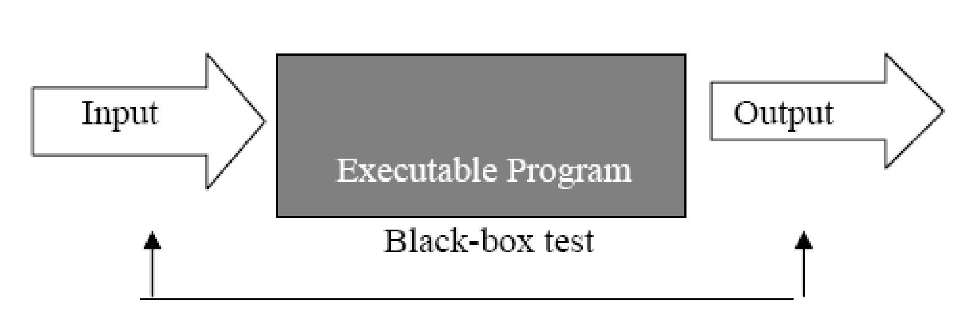
Black-Box Testing (Cont.)
Takes into account only the input and output of the software without any regard to the internal code of the program

Slide 51
Test Case Design
Involves designing the test cases (inputs and outputs) used to test the system
The goal of test case design is to create a set of tests that are effective in validation and defect testing
Test case design approaches for dynamic testing:
  Black-Box testing (e.g requirements based testing)
  White-Box testing

Slide 52
What is Requirements-Based Testing?
Requirements-Based Testing is a type of Black-Box Testing.
Definition: Requirements-based testing involves designing test cases directly from the documented requirements of a system (SRS).
Focus: It does not consider the internal structure or implementation of the software. Instead, it verifies that the output aligns with the expected results based on the inputs specified in the requirements.

Slide 53
Requirements-Based Testing
A general principle of requirements engineering is that requirements should be testable
Requirements-based testing is a validation testing technique where you consider each requirement and derive a set of tests for that requirement
generates
generates
generates
Requirement
Test Requirement
Test
Cases
Test Flows

Slide 54

Software Testing Process

Slide 55
Step 1: Collect Requirements
Example requirements from ATM system:
The ATM system must allow the customer to do withdrawal transactions, which each withdrawal is allowed only between RM10-RM300 and in RM10 multiple
The ATM system must provide the customer with the ability to check their account balance, displaying the current available balance on the screen.
The ATM system should allow customers to change their Personal Identification Number (PIN) securely.
The ATM system should provide customers with the ability to request a mini statement, which displays the most recent transactions on their account, including withdrawals, deposits, and transfers.
The ATM system should have a mechanism to retain the customer's card temporarily in case of multiple invalid PIN attempts or suspicious activity, ensuring the security of the account.

Slide 56
Step 2: Generate Test Requirements
Validate that the withdrawal >300 and <10 is not allowed
Validate that the withdrawal of multiple RM10, between RM10-RM300 can be done
Validate that the withdrawal option is offered by the ATM
Withdrawal of non-multiple RM10 is not allowed
Validate that withdrawal is not allowed if the ATM has insufficient money
Validate that withdrawal is not allowed if the user has insufficient balance in his account

Slide 57
Step 3: Design Test Case based on Test Requirements
When designing the test cases, the Actual Results & Pass / Fail columns are left empty. These columns are filled in as tests are executed.
*Pass when expected = actual
Select requirement:
“The ATM system must allow the customer to do withdrawal transaction, which each withdrawal is allowed only between RM10-RM300 and in RM10 multiple”
Derive the Test Requirement(s) - TR
Choose ONE TR, then design a set of Test Cases
Case # | (Data Value) entered | Expected Results | Actual Results | Pass/Fail

Slide 58
Step 4: List out all Test Cases
“Validate that a withdrawal of a multiple RM10, between RM10-RM300 can be done”
TC ID | RM entered | Expected Results | Actual Results | Pass/Fail
WD01 | 10 | RM10 withdrawn
WD02 | 20 | RM20 withdrawn
WD03 | 30 | RM30 withdrawn
:
WD29 | 290 | RM290 withdrawn
WD30 | 300 | RM300 withdrawn
WD31 | 301 | Error Display
For WD31, if Error Display is expected (Expected Result), and what you get for Actual result is the same, i.e. Error Display, would this test be considered as Pass? Or Fail?

Slide 59
Difference Test Scenario/ Steps and Script
Flow/Procedure:
  Step 1: Insert Card
  Step 2: Enter PIN
  Step 3: Select Withdraw option
  Step 4: Enter amount
  Step 5: Validate amount received
Script: (in pseudo-code)
  Do until EOF
    Input data record
    Send data CARDINFOR to “Card_field”
    Send data “Enter”
    :
    :
    :
Think Manual !
Think Automated!

Slide 60
Software Testing Process

Slide 61
Test Case Design Technique (dynamic testing)
b) Black-box
Requirements based/ specification based testing is an example of black box testing
c) White-box
Black-Box Testing Strategies(*)
i) Equivalence Partitioning (EP)
ii) Boundary Value Analysis (BVA)
i) Basis Path
ii) Control Structure
(*)
(*)
Step 1: draw Flow Graph
Step 2 : calculate Cyclomatic Complexity
Step 3: identify Independent Path
Step 4: Generate Test cases

Slide 62
Black-Box Testing Strategies
Equivalence Partitioning (EP)
Boundary Value Analysis (BVA)

Slide 63
Black-Box Testing Strategies 1:
Equivalence Partitioning
A strategy that can be used to reduce the number of test cases that need to be developed
Divides the input domain of a program into classes
For each of these equivalence classes, the set of data should be treated the same by the module under test and should produce the same answer

Slide 64
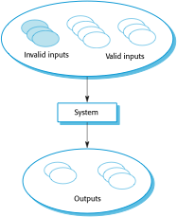
Black-Box Testing Strategies 1:
Equivalence Partitioning (Cont.)
Equivalence classes can be defined:
If an input condition specifies a range or a specific value, one valid and two invalid equivalence classes defined
If an input condition specifies a Boolean or a member of a set, one valid and one invalid

Slide 65
Black-Box Testing Strategies 1:
Equivalence Partitioning (Cont.)
Suppose the specifications for a database product state that the product must be able to handle any number of records from 1 through 16,383
Valid data: Range of 1 to 16383
Invalid data: i) less than 1 ii) More than 16383
For this product, there are 3 equivalence classes:
  Equivalence class 1: less than one record (invalid)
  Equivalence class 2: from 1 to 16,383 records (valid)
  Equivalence class 3: more than 16,383 records (invalid)
Testing the database product then requires that one test class from each equivalence class be selected

Slide 66
Test Cases
Equivalence Class | Status | Representative | Expected Result
Record < 1 | invalid | 0 | Invalid record
1 <= Record <= 16,383 | valid | 10,987 | Product found
Record > 16,383 | invalid | 17,000 | Invalid record
3 test cases

Slide 67
Test Case Design Technique (dynamic testing)
b) Black-box
Requirements based/ specification based testing is an example of black box testing
c) White-box
Black-Box Testing Strategies(*)
i) Equivalence Partitioning (EP)
ii) Boundary Value Analysis (BVA)
i) Basis Path
ii) Control Structure
(*)
(*)
Step 1: draw Flow Graph
Step 2 : calculate Cyclomatic Complexity
Step 3: identify Independent Path
Step 4: Generate Test cases

Slide 68
Black-Box Testing Strategies 2:
Boundary Value Analysis (BVA)
Large number of errors tend to occur at boundaries of the input domain
BVA leads to selection of test cases that exercise boundary values
BVA complements equivalence partitioning
Rather than select any element in an equivalence class, select those at the 'edge' of the class

Slide 69
Black-Box Testing Strategies 2:
BVA (Cont.)
When creating BVA test cases, consider the following:
  If input conditions have a range from a to b (e.g. a=100 and b=300), create partitions:
    Valid range: 100 to 300, 100 and 300
    Invalid range 1: <100
    Invalid range 2: >300
    Then create test cases using the input values that sit at the border (apply inside/outside rule)
    4 test cases, i.e. when value n = 99, 100, 300, and 301
Invalid | Valid | Invalid
99 | 100 300 | 301

Slide 70
Test Cases
Equivalence Class | Status | Representative - BVA | Expected Result
Data < a (100) | invalid | 99 | Invalid data
a (100) <= Data <= b (300) | valid | 100 | Data valid
a (100) <= Data <= b (300) | valid | 300 | Data valid
Data > b (300) | invalid | 301 | Invalid record
4 test cases – due to 4 values of BVA

Slide 71
Test Case Design Technique (dynamic testing)
b) Black-box
Requirements based/ specification based testing is an example of black box testing
c) White-box
Black-Box Testing Strategies(*)
i) Equivalence Partitioning (EP)
ii) Boundary Value Analysis (BVA)
i) Basis Path
ii) Control Structure
(*)
(*)
Step 1: draw Flow Graph
Step 2 : calculate Cyclomatic Complexity
Step 3: identify Independent Path
Step 4: Generate Test cases

Slide 72
Test-Case Design Technique:
White-Box Testing
A verification technique that software engineers can use to examine if their code works as expected
Testing that takes into account the internal mechanism of a system or component (IEEE, 1990)
Also known as structural testing, glass box testing, clear box testing

Slide 73
Test Case Design Technique (dynamic testing)
b) Black-box
c) White-box
Black-Box Testing Strategies(*)
White Box Testing Strategies(*)
i) Equivalence Partitioning (EP)
ii) Boundary Value Analysis (BVA)
i) Basis Path
ii) Control Structure
(*)
(*)
(*)
(*)
Step 1: draw Flow Graph
Step 2 : calculate Cyclomatic Complexity
Step 3: identify Independent Path
Step 4: Generate Test cases

Slide 74
Test-Case Design Technique:
White-Box Testing (Cont.)
A software engineer can design test cases that:
  exercise independent paths within a module or unit
  Exercise logical decisions on both their true and false side
  execute loops at their boundaries and within their operational bounds
  exercise internal data structures to ensure their validity (Pressman, 2001)
Strategies:
  Basis Path Testing / Path Testing
  Control Structure Testing

Slide 75
Test Case Design Technique (dynamic testing)
b) Black-box
c) White-box
Black-Box Testing Strategies(*)
White Box Testing Strategies(*)
i) Equivalence Partitioning (EP)
ii) Boundary Value Analysis (BVA)
i) Basis Path
ii) Control Structure
(*)
(*)
(*)
(*)
Step 1: draw Flow Graph
Step 2 : calculate Cyclomatic Complexity
Step 3: identify Independent Path
Step 4: Generate Test cases

Slide 76
White-Box Testing Strategies 1:
Basis Path Testing
The basis path method allows for the construction of test cases that are guaranteed to execute every statement in the program at least once
This method can be applied to detailed procedural design or source code

Slide 77
White-Box Testing Strategies 1:
Basis Path Testing
The basis path method allows for the construction of test cases that are guaranteed to execute every statement in the program at least once
This method can be applied to detailed procedural design or source code
Steps:
  Draw the flow graph corresponding to the procedural design or code
  Determine the cyclomatic complexity of the flow graph.
  Determine the basis set of independent paths (the cyclomatic complexity indicates the number of paths required)
  Determine a test case that will force the execution of each path

Slide 78
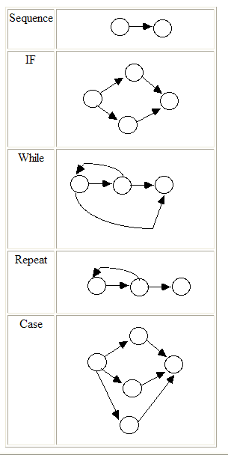
Basis Path Testing Step 1:
Draw Flow Graph
On a flow graph:
  Arrows called edges represent flow of control
  Circles called nodes represent one or more actions
  Areas bounded by edges and nodes called regions
  A predicate node is a node containing a condition

Slide 79
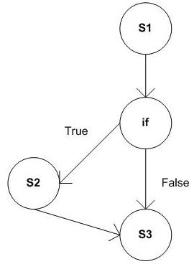
How to Derive Flow Graph: if
S1
If (e)
S2
Endif
  S3

Slide 80
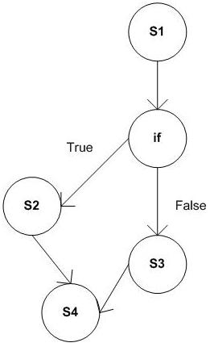
How to Derive Flow Graph: if-else
S1
If (e)
S2
Else
S3
Endif
  S4

Slide 81
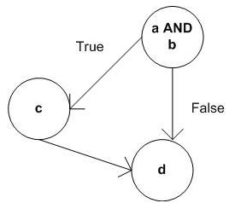
How to Derive Flow Graph: boolean-AND
If (a AND b)
C
End If
D

Slide 82
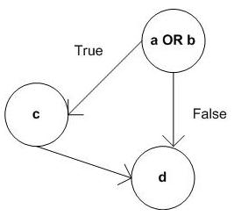
How to Derive Flow Graph: boolean-OR
If (a OR b)
c
End If
d

Slide 83
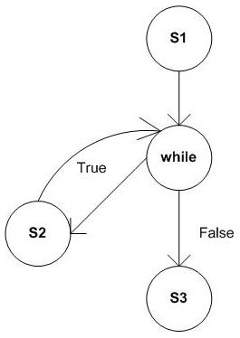
How to Derive Flow Graph: while
S1
While (e)
S2
End while
S3

Slide 84
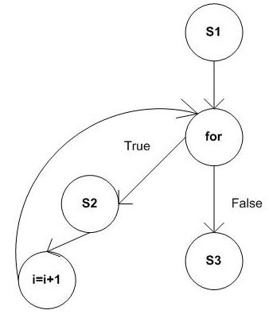
How to Derive Flow Graph: for
S1
for (i=0; i>5; i++)
S2
End for
S3

Slide 85
Example of Basis Path Testing
int main()
{
int i, n, t;
printf("n= ");
scanf("%d ", &n);
if(n < 0)
{
printf("invalid: %d\n", n);
n=-1;
}
else
{
t=1;
for(i=1;i<=n; i++)
{
t*=i;
}
printf("%d != %d\n", n, t);
}
return 0;
}
Given the source code, identify the suitable test cases to be enforced in white-box testing using basis path testing technique

Slide 86
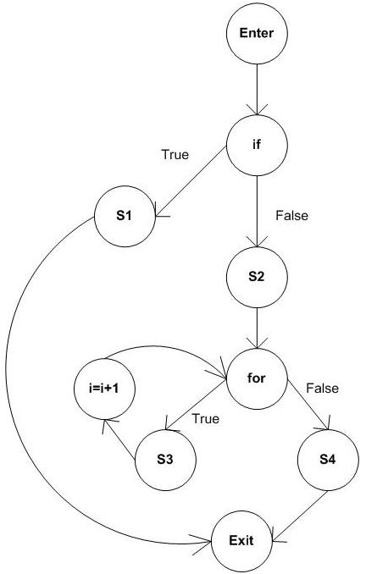
Basis Path Testing Step 1:
Draw Flow Graph
int main()
{
int i, n, t;
printf("n= ");
scanf("%d ", &n);
if(n<0)
{
printf("invalid: %d\n", n);
n=-1;
}
else
{
t=1;
for(i=1;i<=n; i++)
{
t*=i;
}
printf("%d != %d\n", n, t);
}
return 0;}
Enter
if
S1
S2
for
i = i+1
S3
S4
Exit

Slide 87
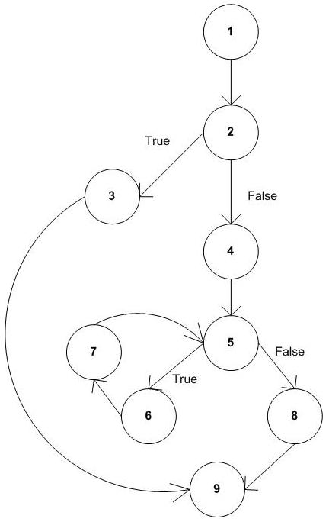
How to Simplify
simplifies

Slide 88
Basis Path Testing Step 2:
Determine Cyclomatic Complexity
Give a quantitative measure of the logical complexity
This value gives the number of independent paths in the basis set, and an upper bound for the number of tests to ensure that each statement is executed at least once
An independent path is any path through a program that introduces at least one new set of processing statements or a new condition i.e. a new edge
3 Formula:
  V(G) = #Edges - #Nodes + 2
  V(G) = #Predicate Nodes + 1
  V(G) = #Region

Slide 89
Basis Path Testing Step 2:
Determine Cyclomatic Complexity
Using 3 formulas (either 1):
  V(G) = #Edges - #Nodes + 2
  = 10 – 9 + 2
  = 3
  V(G) = #Predicate Nodes + 1
  = 2 + 1
  = 3
  V(G) = #Region
  = 3
Region 1
Region 2
Region 3
Node 2 and 5 are predicate nodes (nodes contain conditions)

Slide 90
Basis Path Testing Step 3:
Determine Independent Path
Independent Path:
  1-2-3-9
  1-2-4-5-6-7-5-8-9
  1-2-4-5-8-9

Slide 91
Basis Path Testing Step 4:
Prepare the Test Cases
To complete the white-box testing process, test a program with all three input sets, and verify that the output matches the expected result
If all outputs match, then the code passes the test

Slide 92
int main()
{
int i, n, t;
printf("n = ");
scanf("%d ", &n);
if(n<0)
{
printf("invalid: %d\n", n);
n=-1;
}
else
{
t=1;
for(i=1;i<=n;i++)
{
t*=i;
}
printf("%d != %d\n", n, t);
}
return 0; }
}
1
2
3
4
7
5
6
8
9
Independent Path | Data* for Test Cases | Expected Results/Output
1-2-3-9 | n = -1 | invalid: -1
1-2-4-5-6-7-5-8-9 | n = 1 | 1 != 1
1-2-4-5-8-9 | n = 0 | 0 != 1
*Note: Data should be chosen so that conditions at the predicate nodes are appropriately set as each path is tested

Slide 93
Software Testing Process and Techniques (Summary)
Equivalence Partitioning
Black Box Testing
White Box Testing
Boundary Value Analysis

